Slide 1



Welcome to Sutter Health CPMC’s

Slide 2




BEAUTY AND THE BEAST
Saturday, Sept 15th
Glen Park

Slide 3
Paddington 2
Saturday, Sept 22nd
Upper Noe Valley Rec. Center

Slide 4
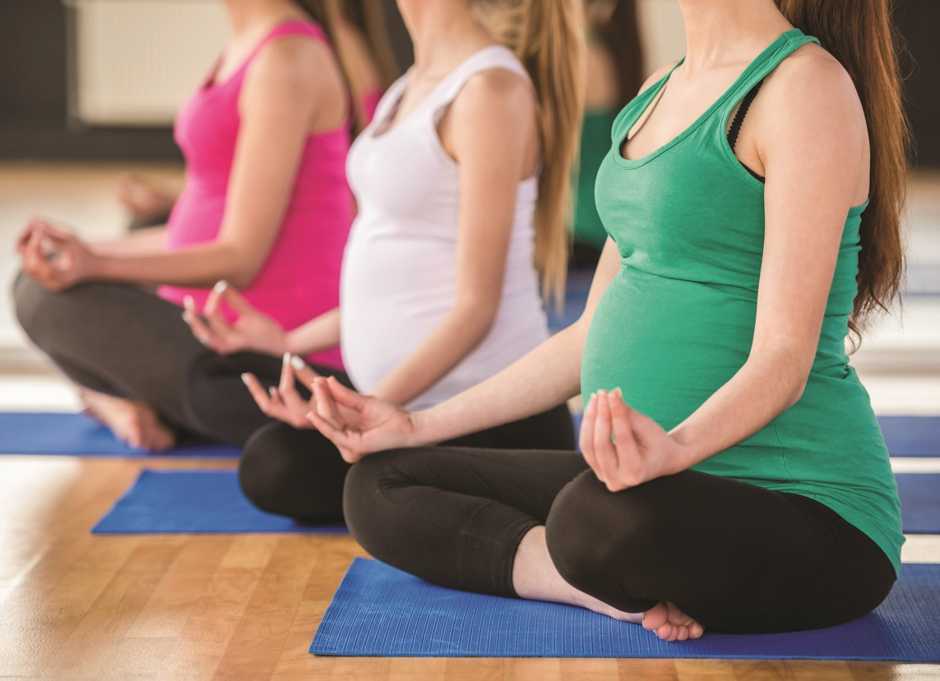

Prenatal yoga.
For the deep breaths now and when the baby arrives.
Remarkable care. Remarkably close.
Learn more at
sutterhealth.org/missionbernal
Remarkable care.
Remarkably close.

Slide 5

Now Open. CPMC’s Mission Bernal Campus
Remarkable care. Remarkably close.
Learn more at
sutterhealth.org/missionbernal

Slide 6
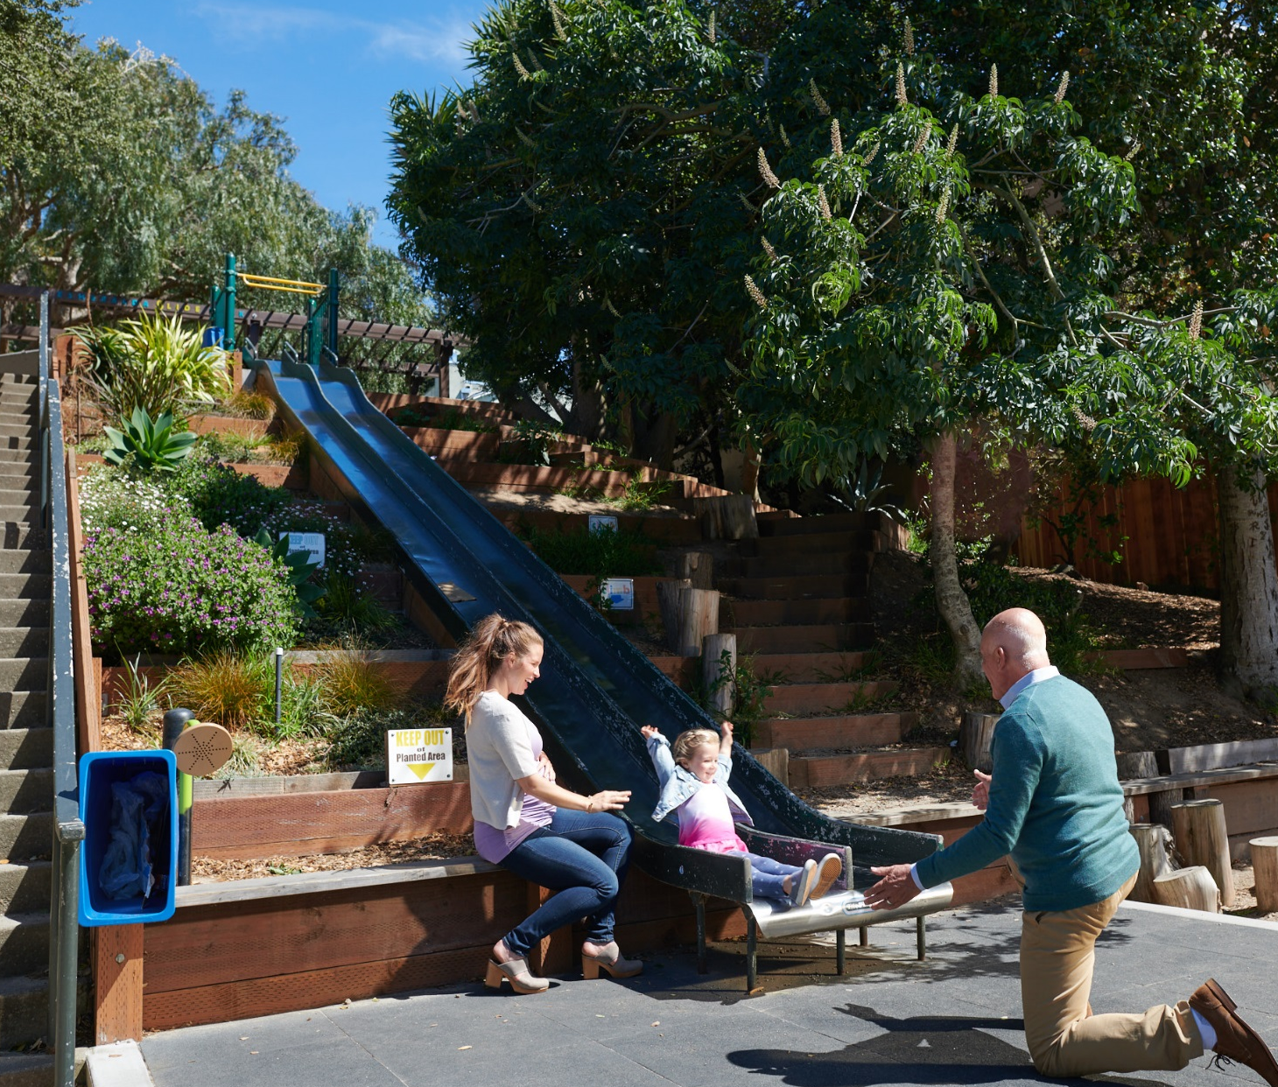
A full range of motion.
CPMC Mission Bernal minimally invasive orthopedic care.
Remarkable care. Remarkably close.
Cesar Chavez & Valencia

Slide 7

Now Open. CPMC’s Mission Bernal Campus
Remarkable care. Remarkably close.
Learn more at
sutterhealth.org/missionbernal

Slide 8
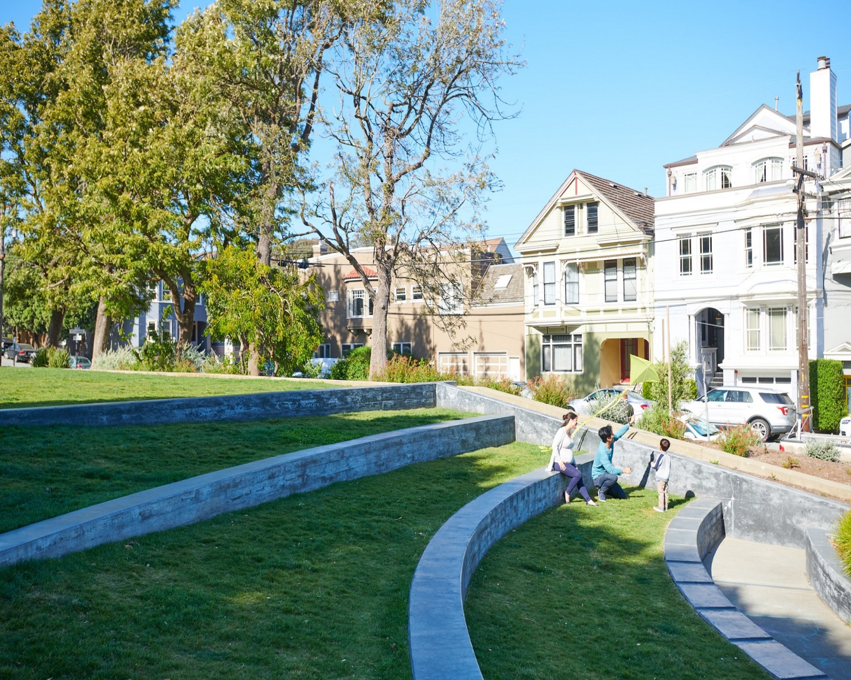
Now Open. CPMC’s Mission Bernal Campus
Remarkable care. Remarkably close.
Learn more at
sutterhealth.org/missionbernal

Slide 9

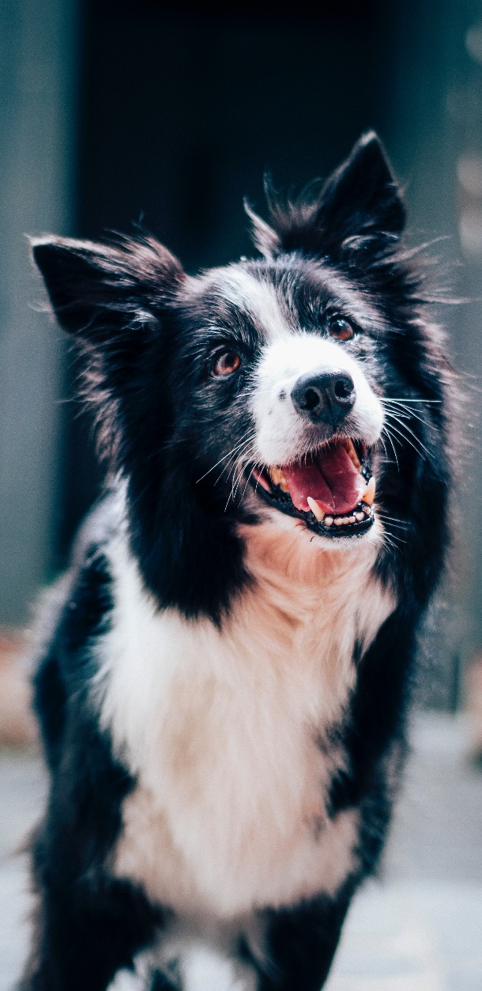
Dedicated ACE Unit.
Acute Care for the Elderly…
…complete with pet therapy.
Remarkable care. Remarkably close.
Learn more at
sutterhealth.org/missionbernal
Remarkable care.
Remarkably close.

Slide 10
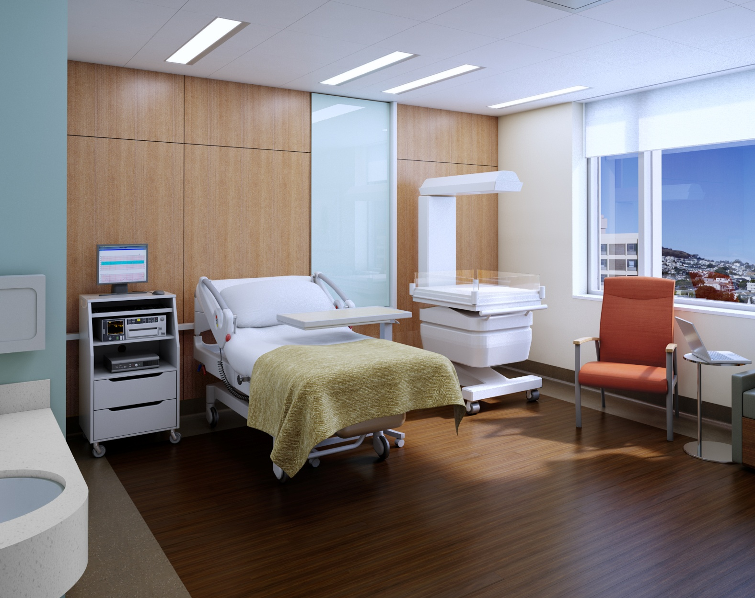

Slide 11
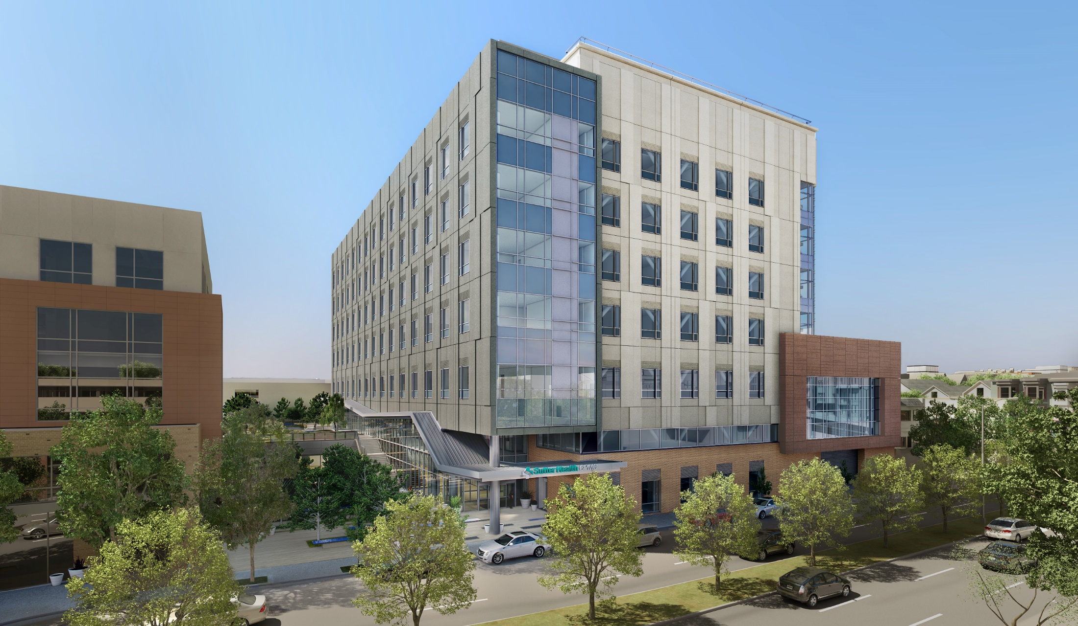
New Hospital at Valencia & Cesar Chavez
Now Open!

Slide 12

Please respect the park and dispose of all trash.

